Slide 1


Slide 2
The Proof and Fruit of Knowing God
1 John 2:3-6

Slide 3


Slide 4


Slide 5


Slide 6
Antichrist Exposed
1 John 2:18-27

Slide 7


Slide 8


Slide 9
Satan’s Great Lie
1 John 3:4-10

Slide 10
The Love the World Loves to Hate
1 John 3:11-18

Slide 11


Slide 12


Slide 13
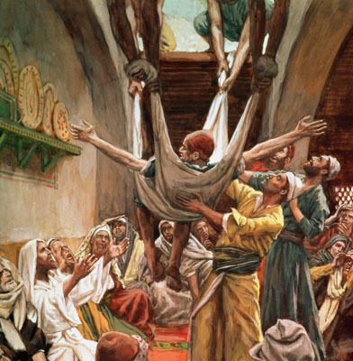
Their Tenacious Faith
Various Scriptures

Slide 14
Keeping the Greatest Commandment
1 John 4:7-12

